Slide 1


High Harmonic Generation with Plasmonic Enhancements
Khadija Ahmed, Rahima Ahmed, Natnael Amanuel, Judith Joseph Antony, Joseph Connole, Dhruba Fahmiduzzaman, Safee Hussain, Javeer Joarder, Mouid Khan, Malaika Khan, Darshana Kottaisamy, Anica Tahsin, Rabi Tariq, Adeyinka Thomas, Calin Novogreblevschi, Gabriel Apoitia Previti, Fahmida Akter Rahman, Ashraf Rahman, Tabeeb Rahman, Umor Sahil, Kamer Shkrepi, Mia Strickland, Hifzur Rahman, Fahmin Shejuti, and Dr. Serena A. Maugeri
Newham Collegiate Sixth Form
A.C. Bray, C. Hofmann
Department of Physics & Astronomy, University College London, United Kingdom
ORBYTS Conference, 22 June 2022

Slide 2
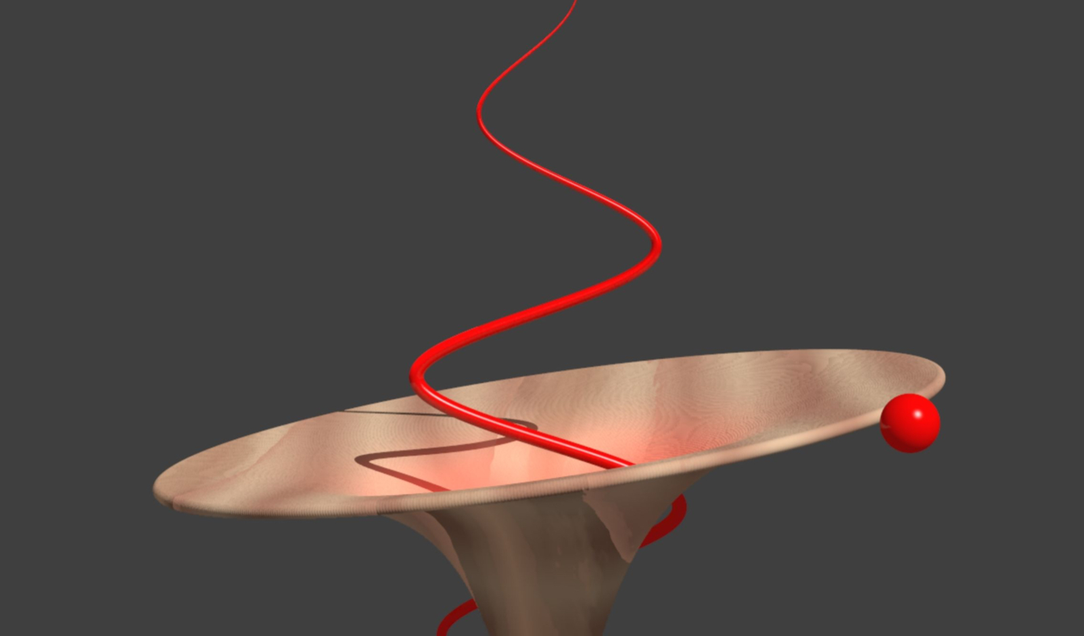
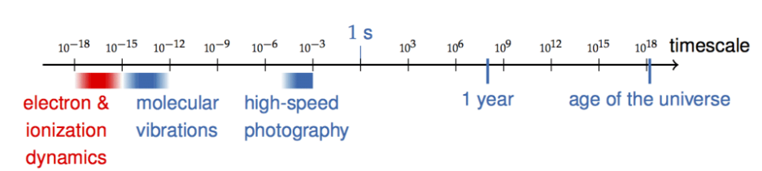
Introduction to Attoscience
One attosecond = 1x10^-18 seconds
Strong field = coulomb potential
Image By A C Bray and C Hofmann
Notes:
Attoscience focuses on events happening on a subatomic level.
One attosecond can be expressed as 1x10^-18 seconds.
Attoscience has helped to pioneer new and exciting technologies such as the photovoltaic cell.
Continued research into attoscience can help us discover new and exciting quantum processes that we can utilise in our technologies.

Slide 3
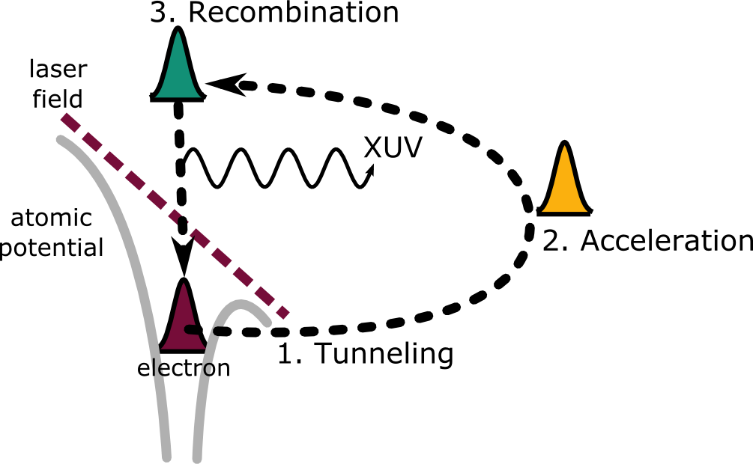
Systems of Interest
Analysis of the impact of lasers and their strong fields on electrons bound to their parent ions
3 step model: Tunneling, Acceleration, Recombination
The results we obtain will differ depending on the properties of the laser.
Notes:
Bullet point 1:
We looked at the interaction between the strong field created by the laser, and an electron bound to its parents ion. We fire the laser at the e- and it gains enough energy to leave the atom. Electrons may then circle back and recombine
Bullet point 2:
“So in simple terms the entire process can be summarised into 3 key stages called the 3 step model as seen on the board: Tunneling, Acceleration, and as I mentioned just now, Recombination”
Bullet point 3:
“The results we obtain will differ depending on the properties of the laser. Now what exactly is a laser. And how can they be used in attoscience?”

Slide 4
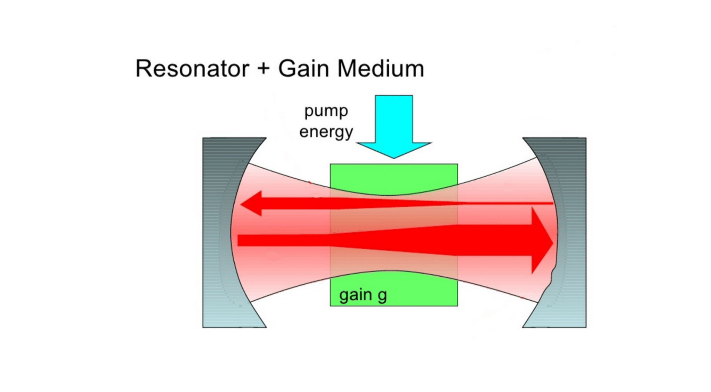
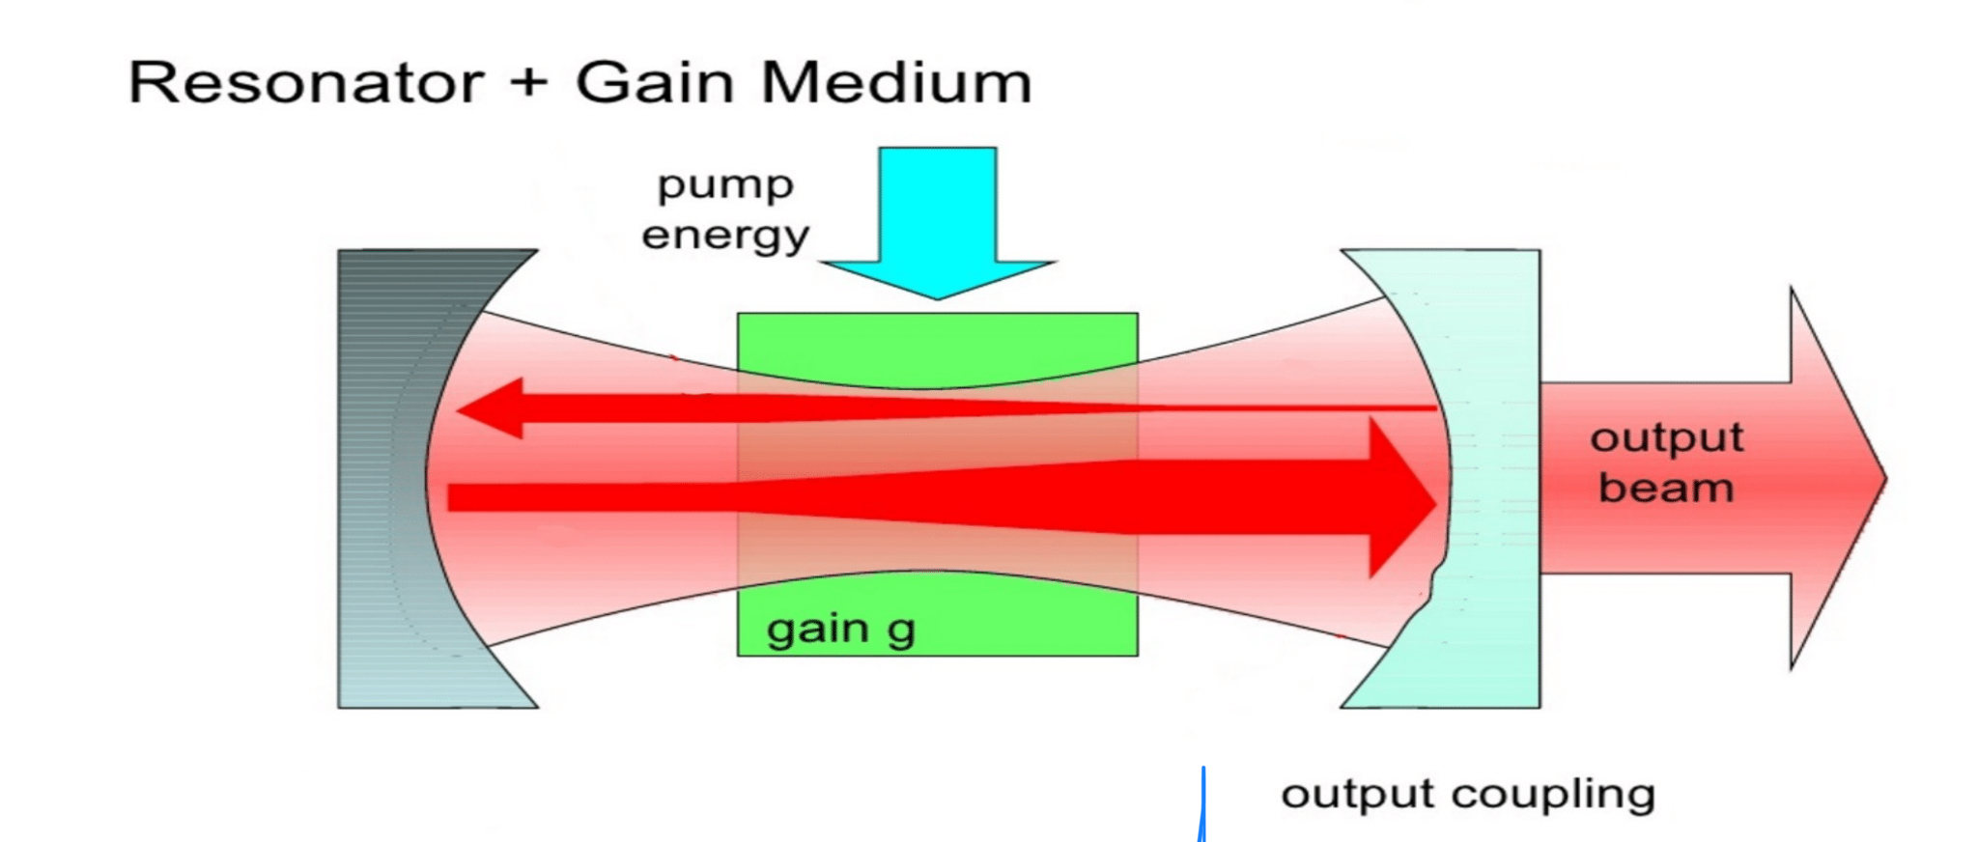
What is a laser?
Stimulates atoms to emit light at different wavelength
Bern university of applied sciences(Engineering and information technology)
Notes:
A laser stimulates atoms or molecules to emit particular wavelengths
The optical resonator is an arrangement that allows a beam of light to circulate in a closed path
As shown in the picture a beam of light is passed through a gain medium ; the purpose of the gain medium is that it can amplify the power of the light beam
Energy is transferred from an external source to the gain medium ( laser pumping)
which results in an output beam being generated through output coupling- this is a part of the optical resonator which allows the extraction of a portion of the light to generate the output beam carlos aristizabel

Slide 5

Types of polarisation
Linear
Circular
Elliptical
Introduction to Polarization-https://www.edmundoptics.co.uk/knowledge-center/application-notes/optics/introduction-to-polarization/
Notes:
Firstly, what is polarisation?
Polarisation is the restriction of oscillations to one plane. In our project we learned about three types of polarisation. Later on you’ll see that the inherent abilities of a certain types of waves makes them unusable when reacting HHG.
Linear polarization: the electric field of light is confined to a single plane along the direction of propagation
Circular polarization: two linear components that are perpendicular to each other rotating in a circle around the direction of propagation Elliptical polarization: results from the combination of two linear components with different amplitudes and/or a phase difference.

Slide 6
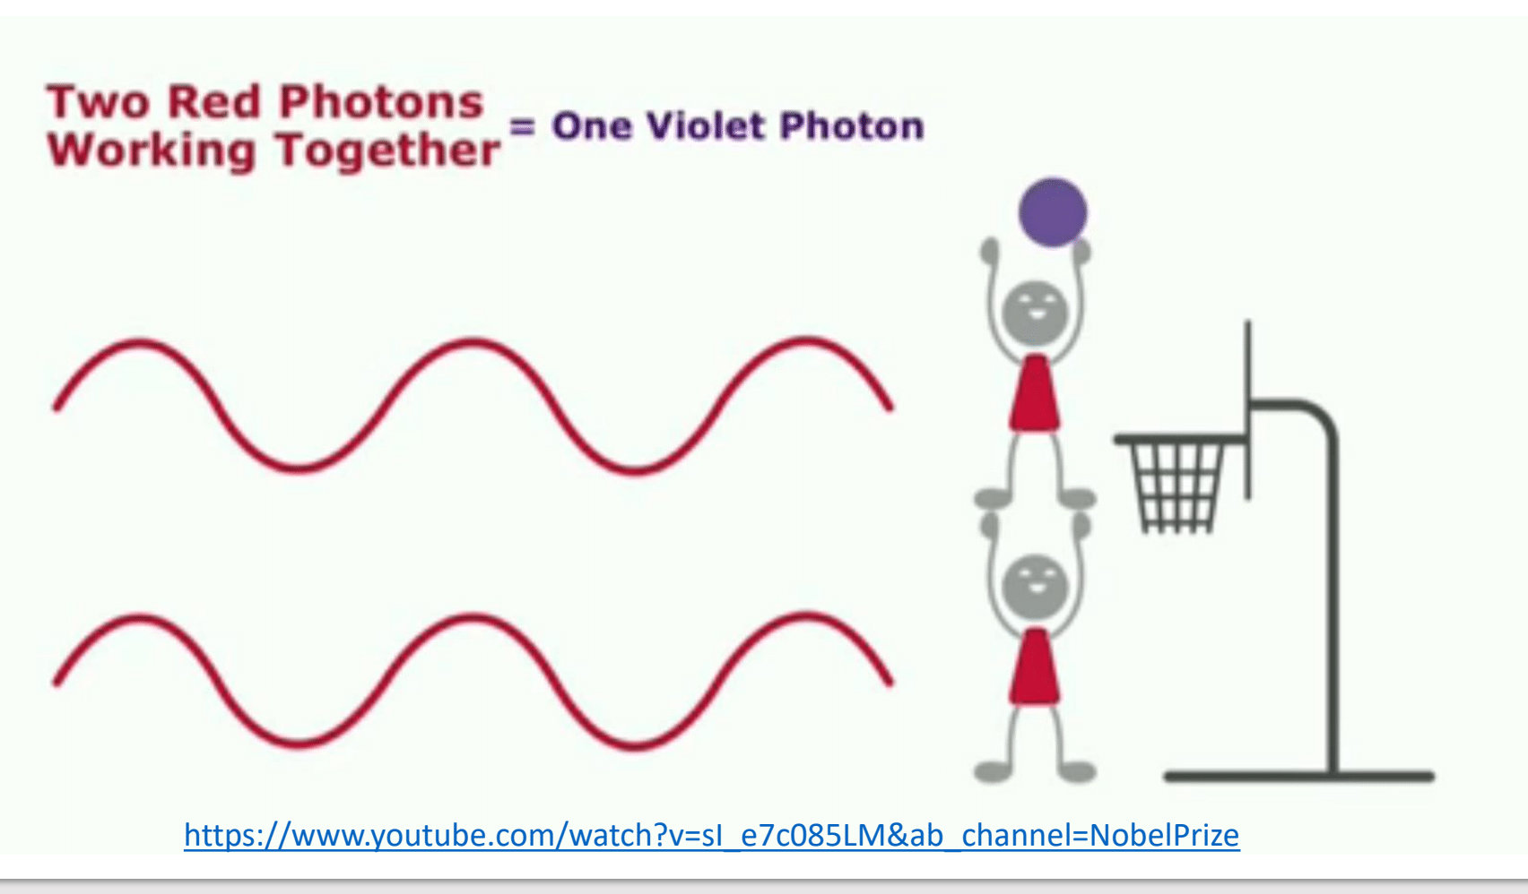
Motivation for XUV
Input IR to XUV
Attoseconds
vs.
femtoseconds
Notes:
After the field begins the oscillate the the electron returns the parent ion with higher energy and the photon is released. This energy released is the HHG.
We put in Infrared radiation to get high energy XUV photons out. We want this because everything about electrons happens at attosecond scale but IR can monitor at femtoseconds. XUV will allow us to look at atoms in real time without delay and we will be able to understand more about it.
Knowing about atoms will help us to learn more about molecule, materials and in turn how efficiently we can use these materials in solving out current problems.

Slide 7
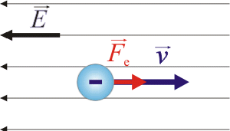
Forces
Force and electron motion
Formula to use: F = ma
In this case, we will make the mass of the electron to have a unit mass of “1”, therefore F = a
The electric field that interacts with the electron will experience a force that’s in opposite in direction with the electric field, E(t)
So E(t) = -F, E(t) = -a.
a
Notes:
Image: https://physictasks.eu

Slide 8
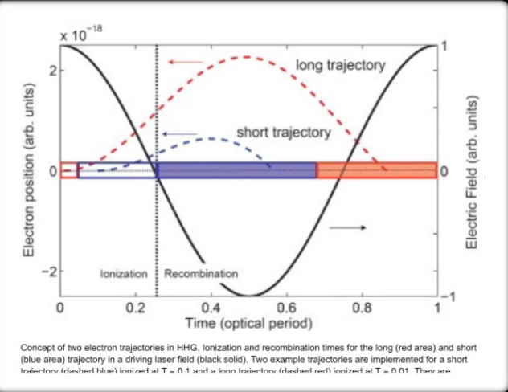
Trajectory
Returning near ion for HHG- recombining.
How electrons recombine?
Effect of laser field on electrons leaving parent ion.
What is a trajectory?
Many electrons have different trajectories. Long and short?
Image by Deutsche Physikalische Gesellschaft

Slide 9
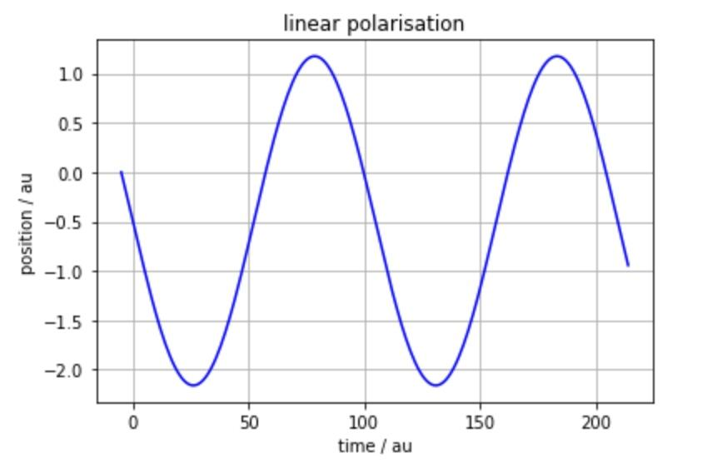
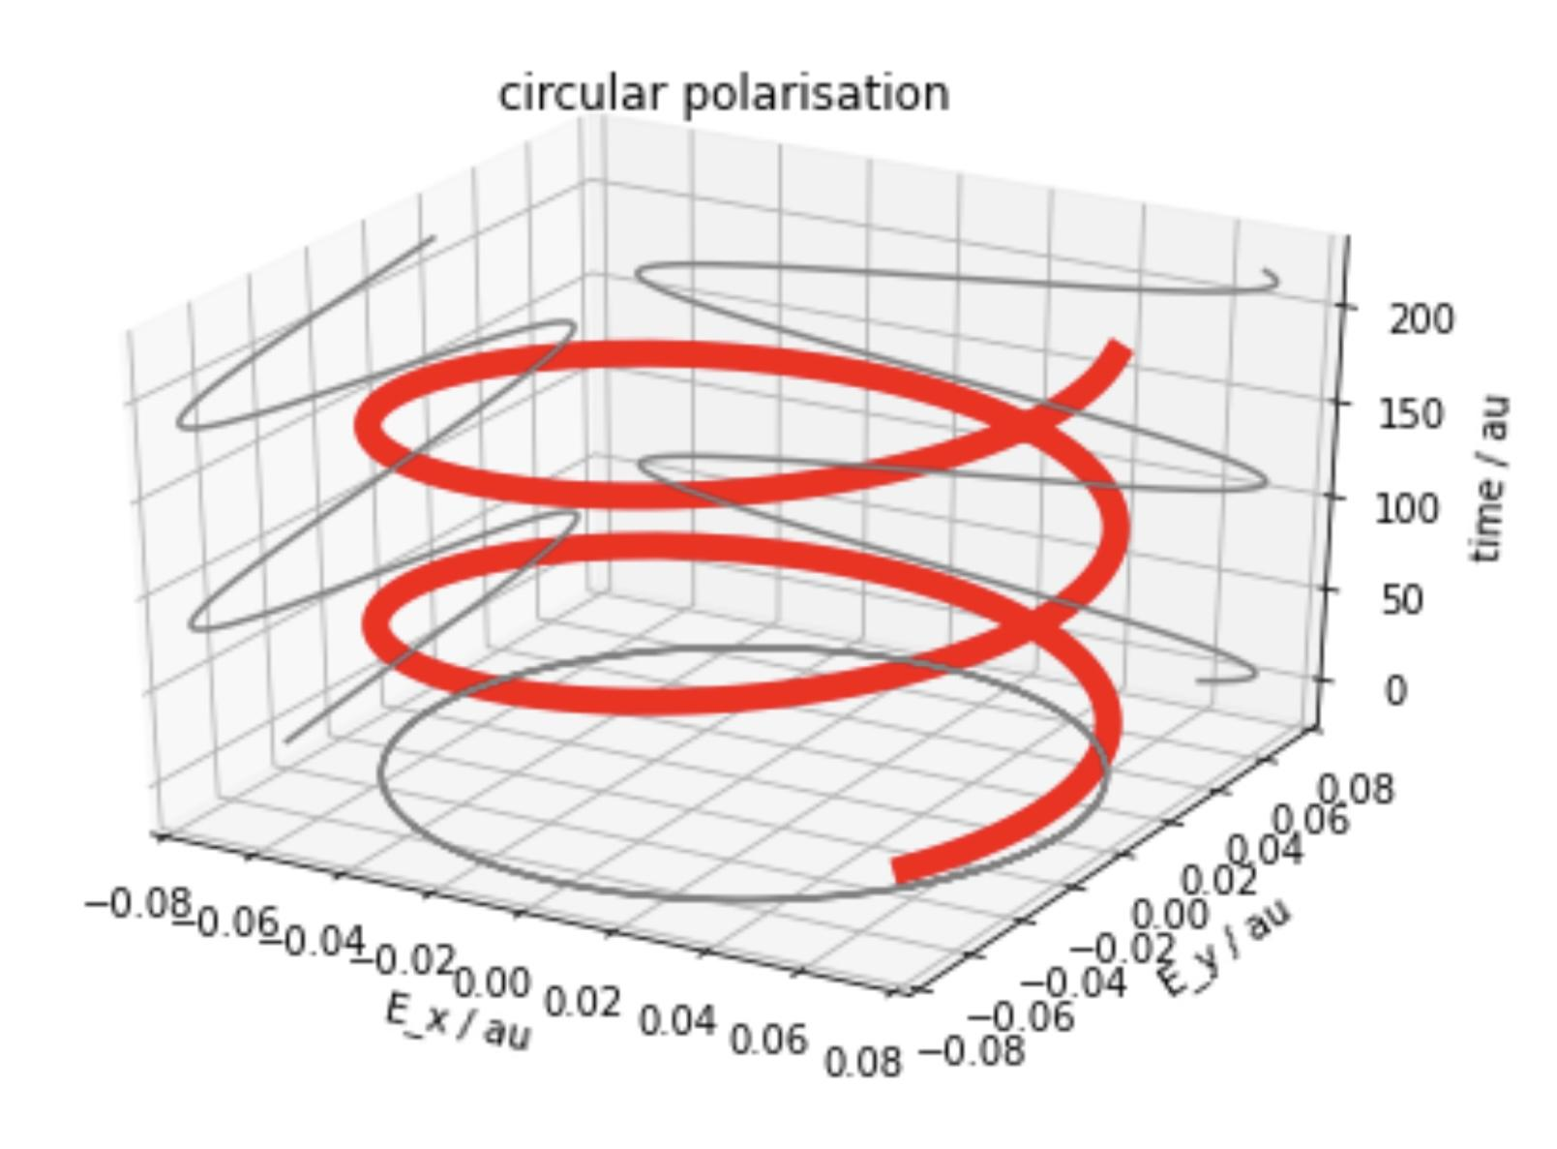
Linear Polarisation Circular Polarisation
During Linear polarisation,electrons move back and forth in one line and in any direction
The electron does recombine.
The resulting electric field rotates in a circle around the direction of propagation.
During circular polarisation, the electron does not recombine with the parent ion.

Slide 10
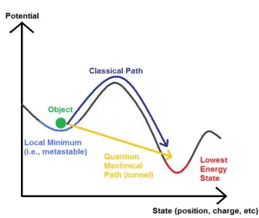
Quantum Tunnelling
Takes effect when Electrons move through barriers you wouldn’t expect them to.
A strong electric field disrupts the coulomb potential of an electron. An electron is accelerated direction of the trajectory is changed (The field begins to oscillate).
Link: https://bigthink.com/technology-innovation/physicists-leverage-quantum-tunneling-to-collect-energy-from-earths-heat/
Notes:
image : https://bigthink.com/technology-innovation/physicists-leverage-quantum-tunneling-to-collect-energy-from-earths-heat/

Slide 11
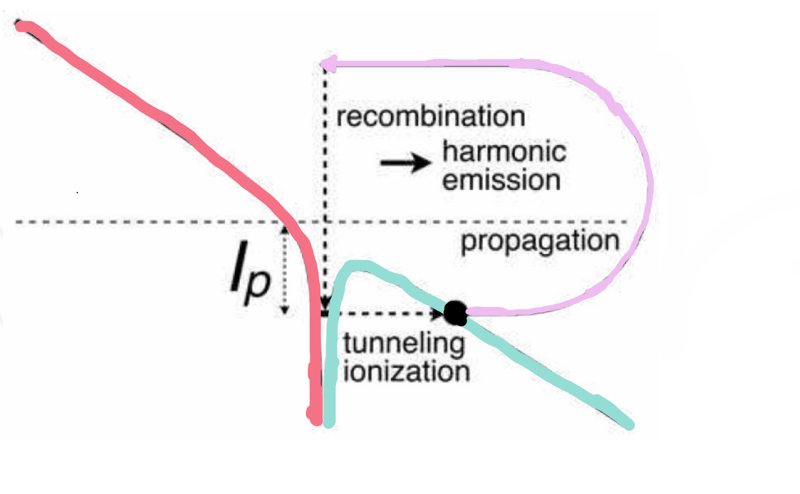
The Three Step Model
Tunnel Ionisation
An electron leaves the target atom/molecule through the process of quantum tunneling and is accelerated by the laser field.
Propagation/Acceleration
The released electron propagates in the continuum, on a trajectory outside the target atom/molecule until it travels close to the Coulomb potential of its parent ion
Recombination
The electron returns to its parent ion with more energy
Reference: DOI:10.5772/7961
Notes:
DOI:10.5772/7961

Slide 12
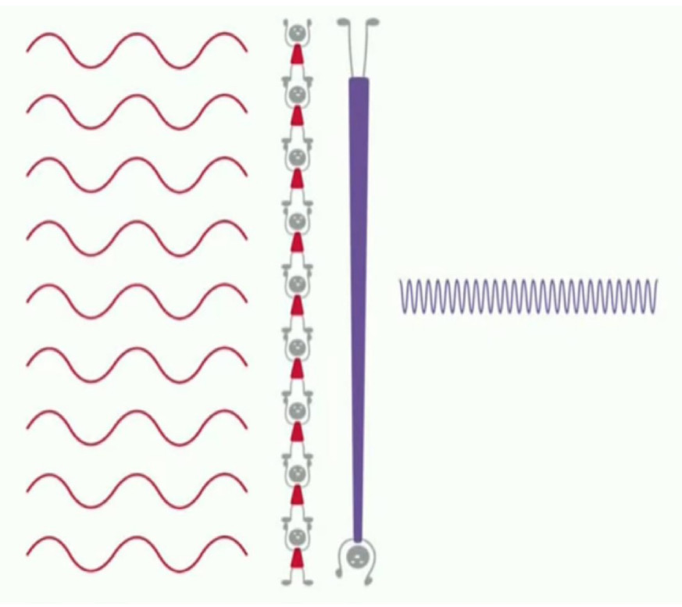
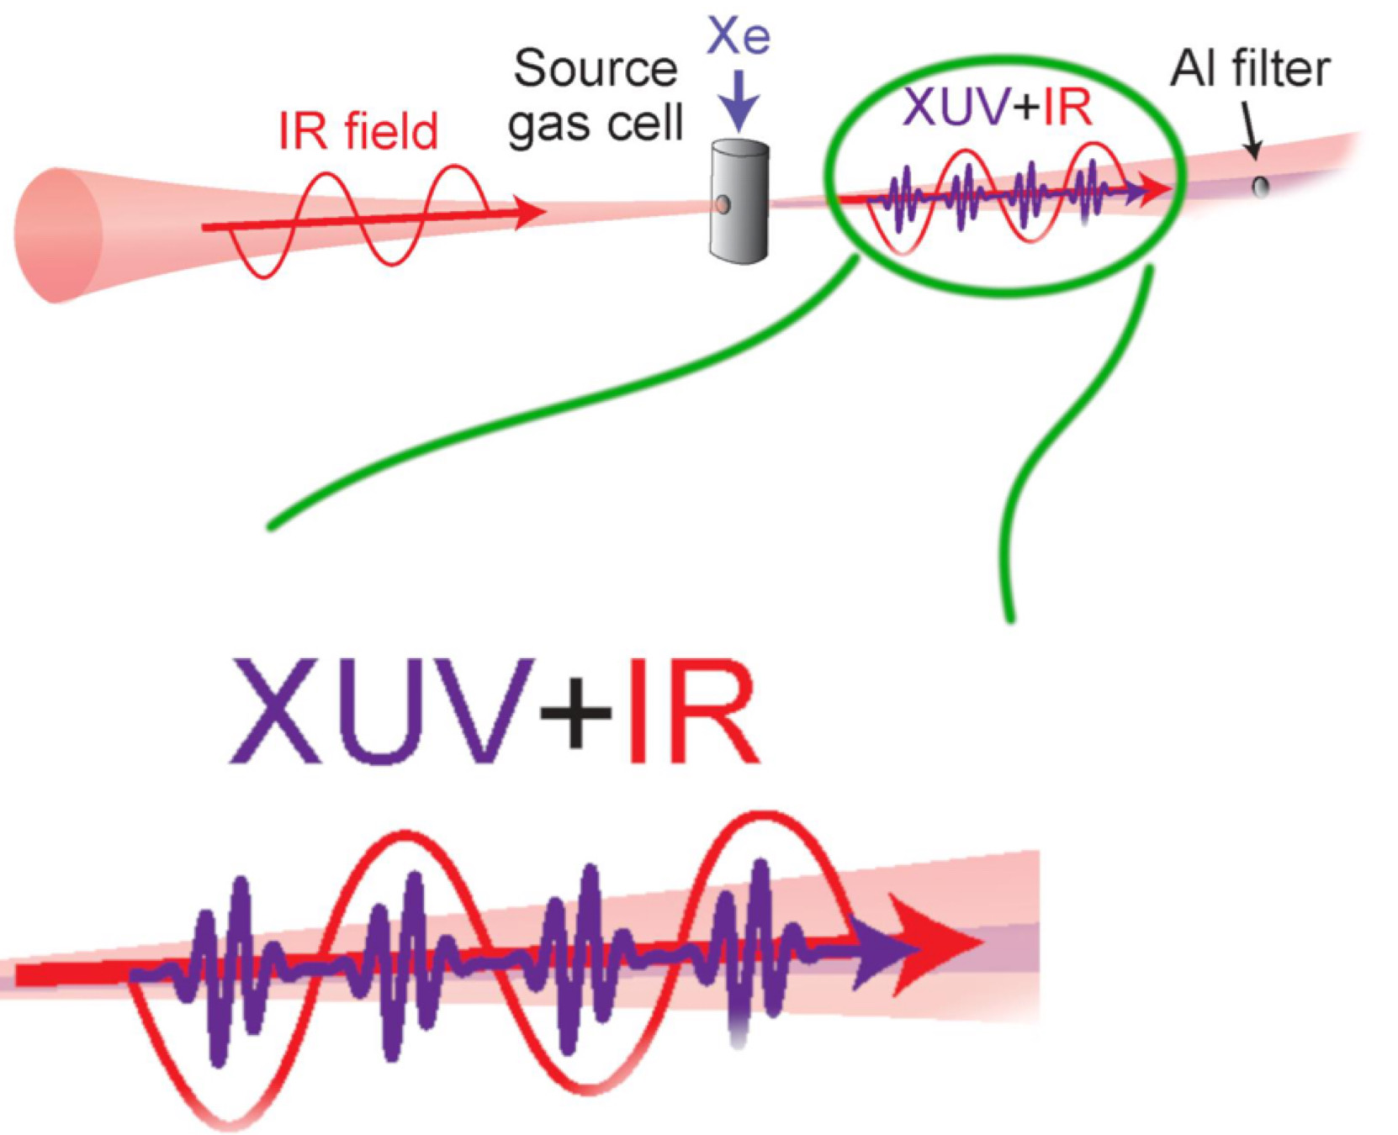
High Harmonic Generation
Energy of electron at recombination ⩰ Energy of XUV Pulse
Notes:
Reference: Dr Hofmann and Abbie Bray

Slide 13
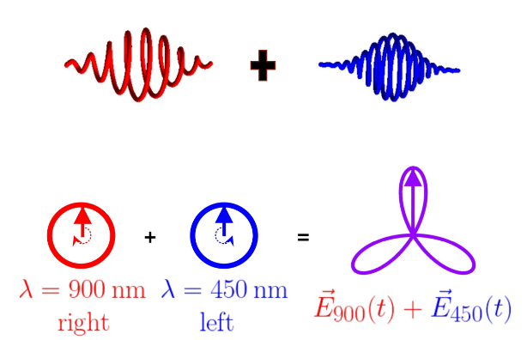
What is the optical model?
Our optical model is a superposition of two circularly polarised EM waves
In what is called the homogenous setup One EM wave rotates in opposite direction 2x frequency (see FIG 1) of the other
Relative rotational frequency is 3 (1 cw, -2 ccw, 1-(-2)=3)
Leads to trifold petal pattern (see FIG 1) with an order of rotational symmetry of 3 with a maxima every ⅓ of a rotation (optical period of 1/3)
FIG 1

Slide 14
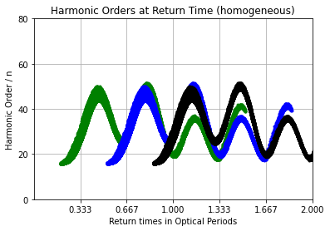
Why do we use this optical model?
Used because its super easy to modify shape of wave by slight deviations from the homogenous case.
The linear model is more limited in the waveforms produced, because it is more difficult to manipulate XUV pulses.
But expectedly in the homogenous case, (see FIG 2) we see a regular sinusoidal shape representing the maximas passing through the atom.
FIG 2

Slide 15
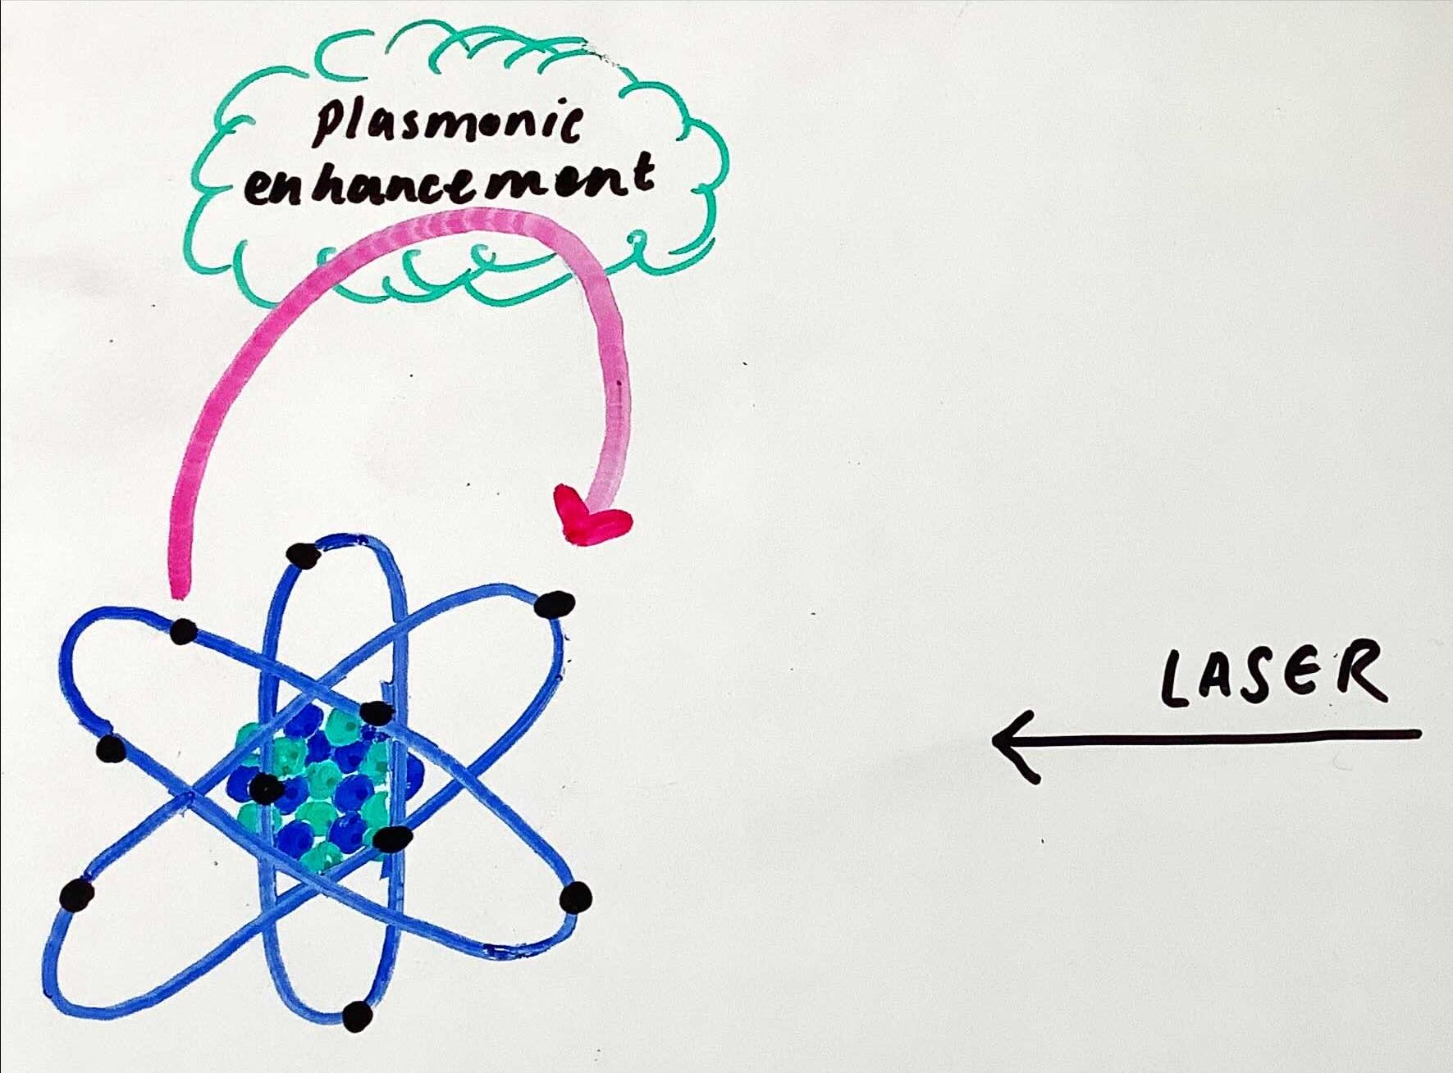
Plasmonic enhancement:
So far, we have a scenario in which a laser fires at a neon atom causing an electron to be ejected and undergo the three step model.
However, we could add plasmonic enhancement.
Nanosphere located at x = 297 au
Electric field strength = length of arrow

Slide 16
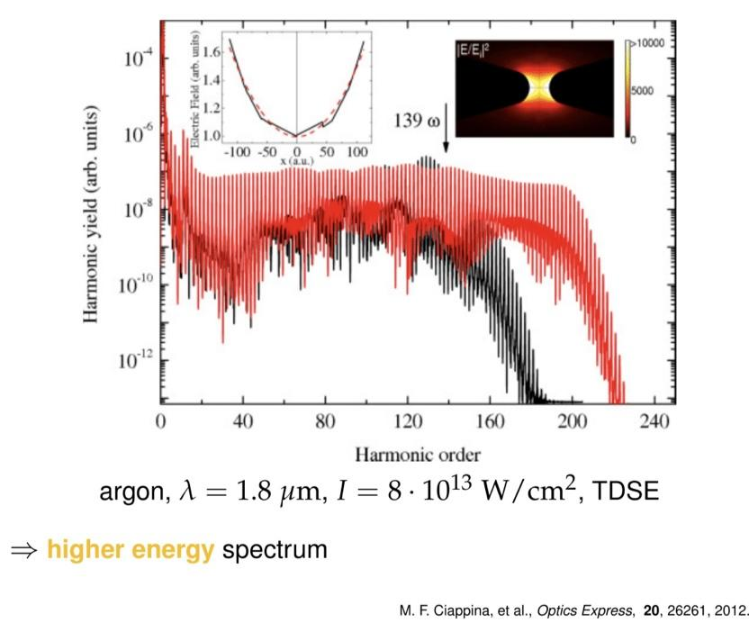
Our parameters with plasmonic enhancement
Using plasmonic enhancements, we are able to reach a higher harmonic order
This enables us to investigate more values and make more observations on them
Key:
- Plasmonic enhancement
- No plasmonic
enhancement

Slide 17
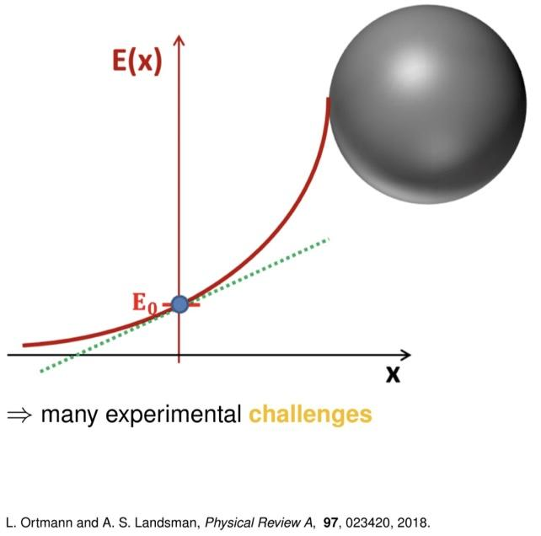
Linear vs cubic model
Linear model | Cubic model
Only works for a small range of travel distance for the electrons Not a good mathematical model for what we want to represent When the linear model intercepts the x-axis, the + sign changes to a - sign despite the electric field not actually changing to the opposite direction. | Provides a mathematical model with an improved spatial dependence on the electric field
KEY
Cubic model
Linear Model

Slide 18
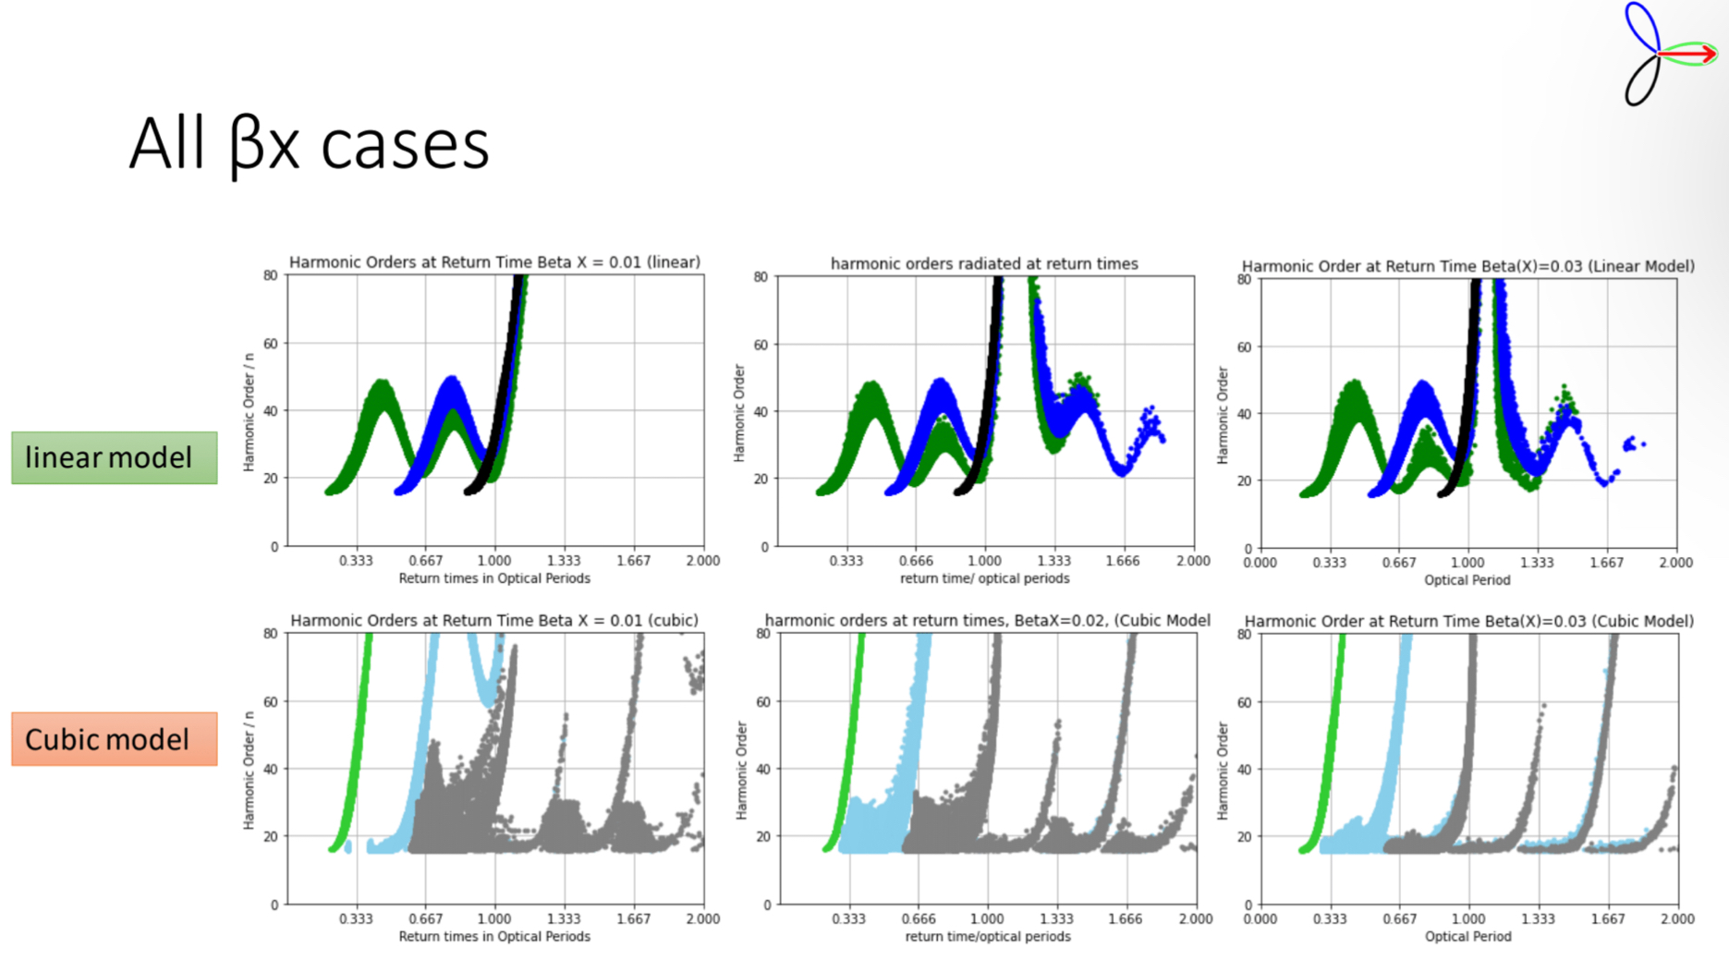
Data & Results
Notes:
Beta(x) Comparisons:
1st lobe, electron travels in the negative x direction – does not recombine
Electron that gives from travelling in the negative x direction to travelling down the y direction, recombines. Causes short trajectories.
Beta x cubic: as enhancements increase, results become more uniform. Stronger lasers -> more similar trajectories, more enhanced, the stronger the laser, the longer the trajectories, higher the energy.
Linear beta x: higher the enhancement, there are longer trajectories, more variation with results I
Cubic beta x: higher the enhancement there are more short trajectories, hence results being more uniform (less variation with trajectories)
Periodic patterns can be seen every third orbital period for the majority of graphs, showing the tri-fold symmetry of the cubic model.

Slide 19
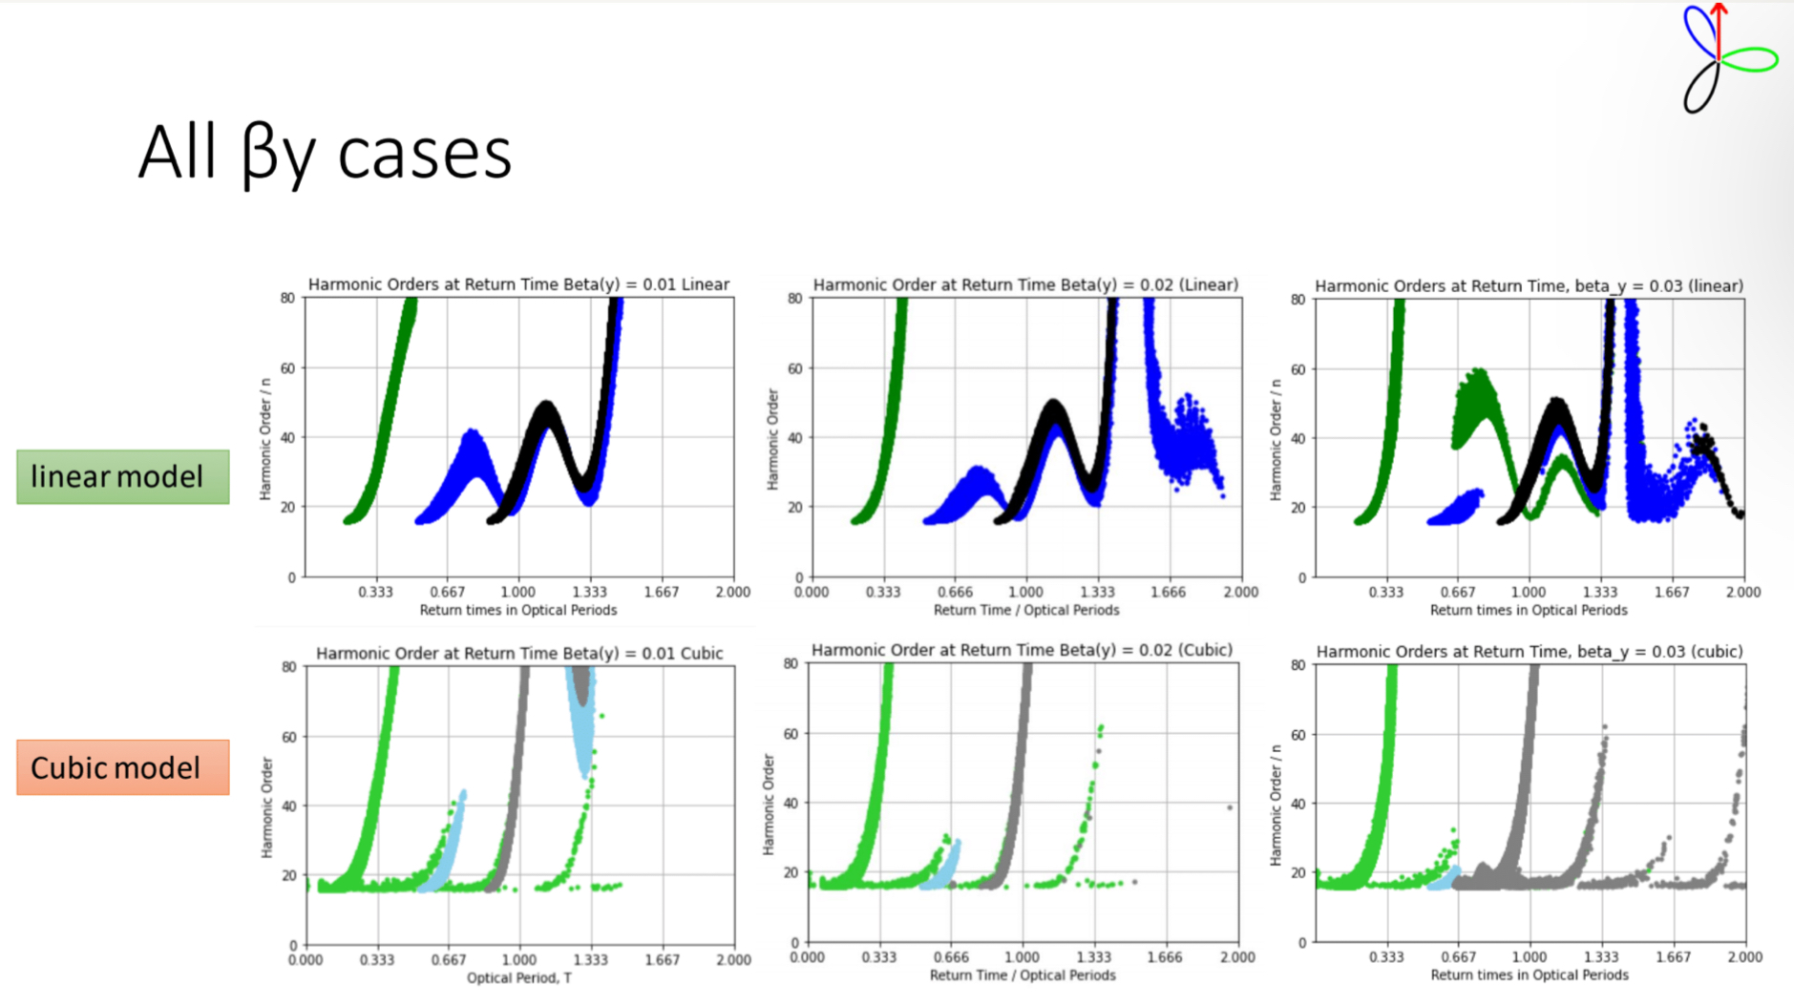
Notes:
Beta(y) Comparison:
Minimum harmonic order of 18 regardless of the enhancement, although the maximum value varies
Increasing the enhancement leads to suppression of the second (blue lobe) to a much greater extent. Suppressed energy is caused when the electron (lobe) travels in the opposite y direction therefore moving further away from the laser field so it has lower energies and therefore lower harmonic orders.
Due to the restrictions on our graphs, we cannot see what harmonic orders are reached by the first (green) and third (black) lobes.
While increasing the magnitude of the enhancement in the cubic model decreased the number of electrons ionised in the green lobe that had long trajectories however it increased the number of electrons ionised in the black lobe that underwent long trajectories, as seen with the number of grey spikes on the beta(y=0.03) graph.

Slide 20
Thank you for listening!

